Slide 1
Preparing for Work with PPE
By Edgar Flores

Slide 2
Introduction
For someone who works in an engineering based job that involves a lot of physical and dangerous work, special equipment is required in order to prevent accidents. This we call “PPE” meaning “Personal Protective Equipment”

Slide 3
Hearing Protection
Workers exposed to excessive noise must use appropriate PPE. Hearing protection is part of a hearing conservation program, which is required when noise exposure exceeds the action level [85 decibels on the A scale (dBA)]

Slide 4
Respiratory Protection
When employees must work in environments with insufficient oxygen or where harmful dusts, fogs, smokes, mists, fumes, gases, vapors, or sprays are present, they need respirators. A respirator is a protective device that covers the nose and mouth or the entire face or head to guard the wearer against hazardous atmospheres. These health hazards may cause cancer, lung impairment, other diseases, or death.

Slide 5
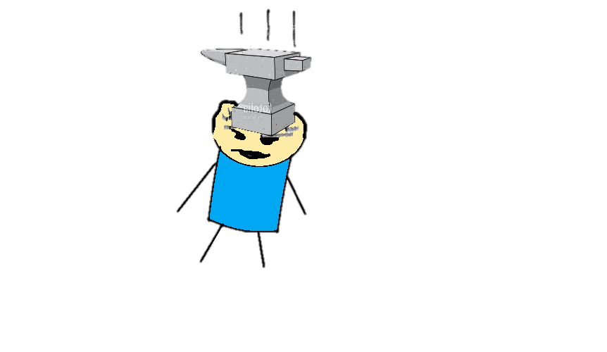
Safety Helmet
All employees working in areas where there is a possible danger of head injury from impact, or from falling or flying objects, or from electrical shock and burns, shall be protected by protective helmets. In these situations the use of a safety helmet will help protect against injuries to the scalp, skull and cervical vertebrae.

Slide 6
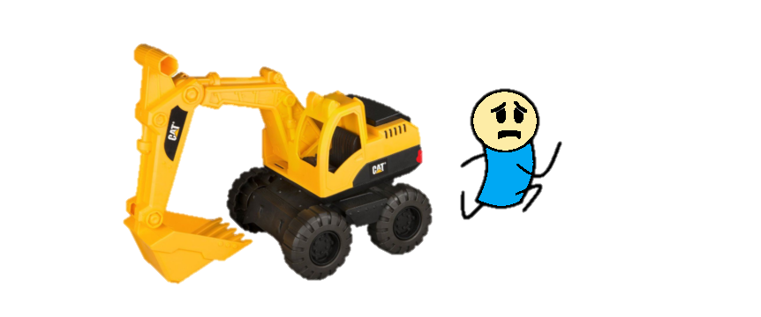
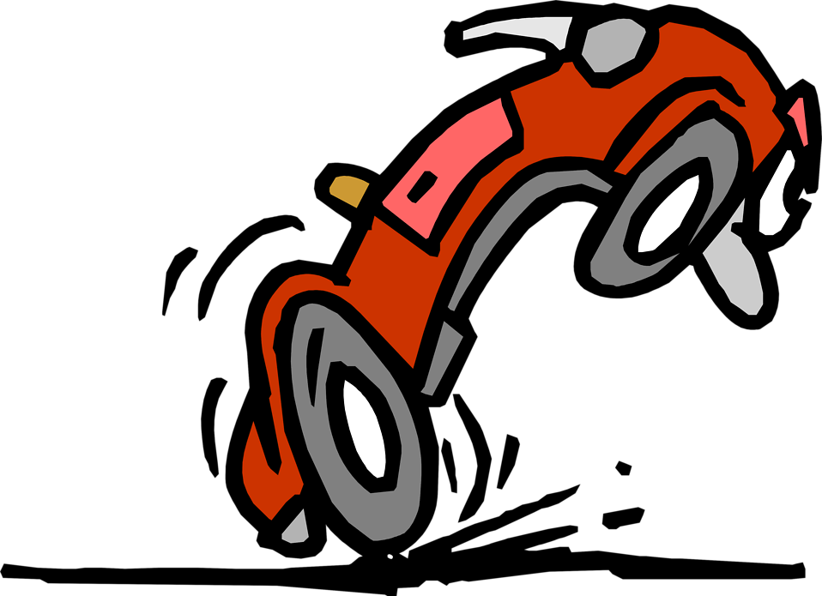
High Visibility Safety Apparel
High-visibility safety apparel (HVSA) is needed if you work when there is low light and poor visibility, especially if you are working around moving vehicles. High-visibility safety apparel (HVSA) is clothing that workers can wear to improve how well other people "see" them.

Slide 7
Safety Boots
Construction workers should wear work shoes or boots with slip-resistant and puncture-resistant soles. Safety-toed footwear is worn to prevent crushed toes when working around heavy equipment or falling objects.

Slide 8
Safety Gloves
Onsite in construction/engineering environments, safety gloves protect workers while materials handling, using tools, operating heavy equipment, and more. Developed with impact and cut protection while providing dexterity and comfort.

Slide 9
Safety Glasses/Face Protection
Workplace eye protection is needed when the following potential eye hazards are present:
Projectiles (dust, concrete, metal, wood and other particles)
Chemicals (splashes and fumes)
Radiation (especially visible light, ultraviolet radiation, heat or infrared radiation, and lasers)
Bloodborne pathogens (hepatitis or HIV) from blood and body fluids

Slide 10
Looks like our Engineer’s PPE is ready for work
Safety Helmet
Safety Glasses and Ear Muffs
Respirator
Safety Gloves and High Visibility Suit
Safety Boots

