Slide 1
Circular Saw Safety
By Jessie Vo

Slide 2
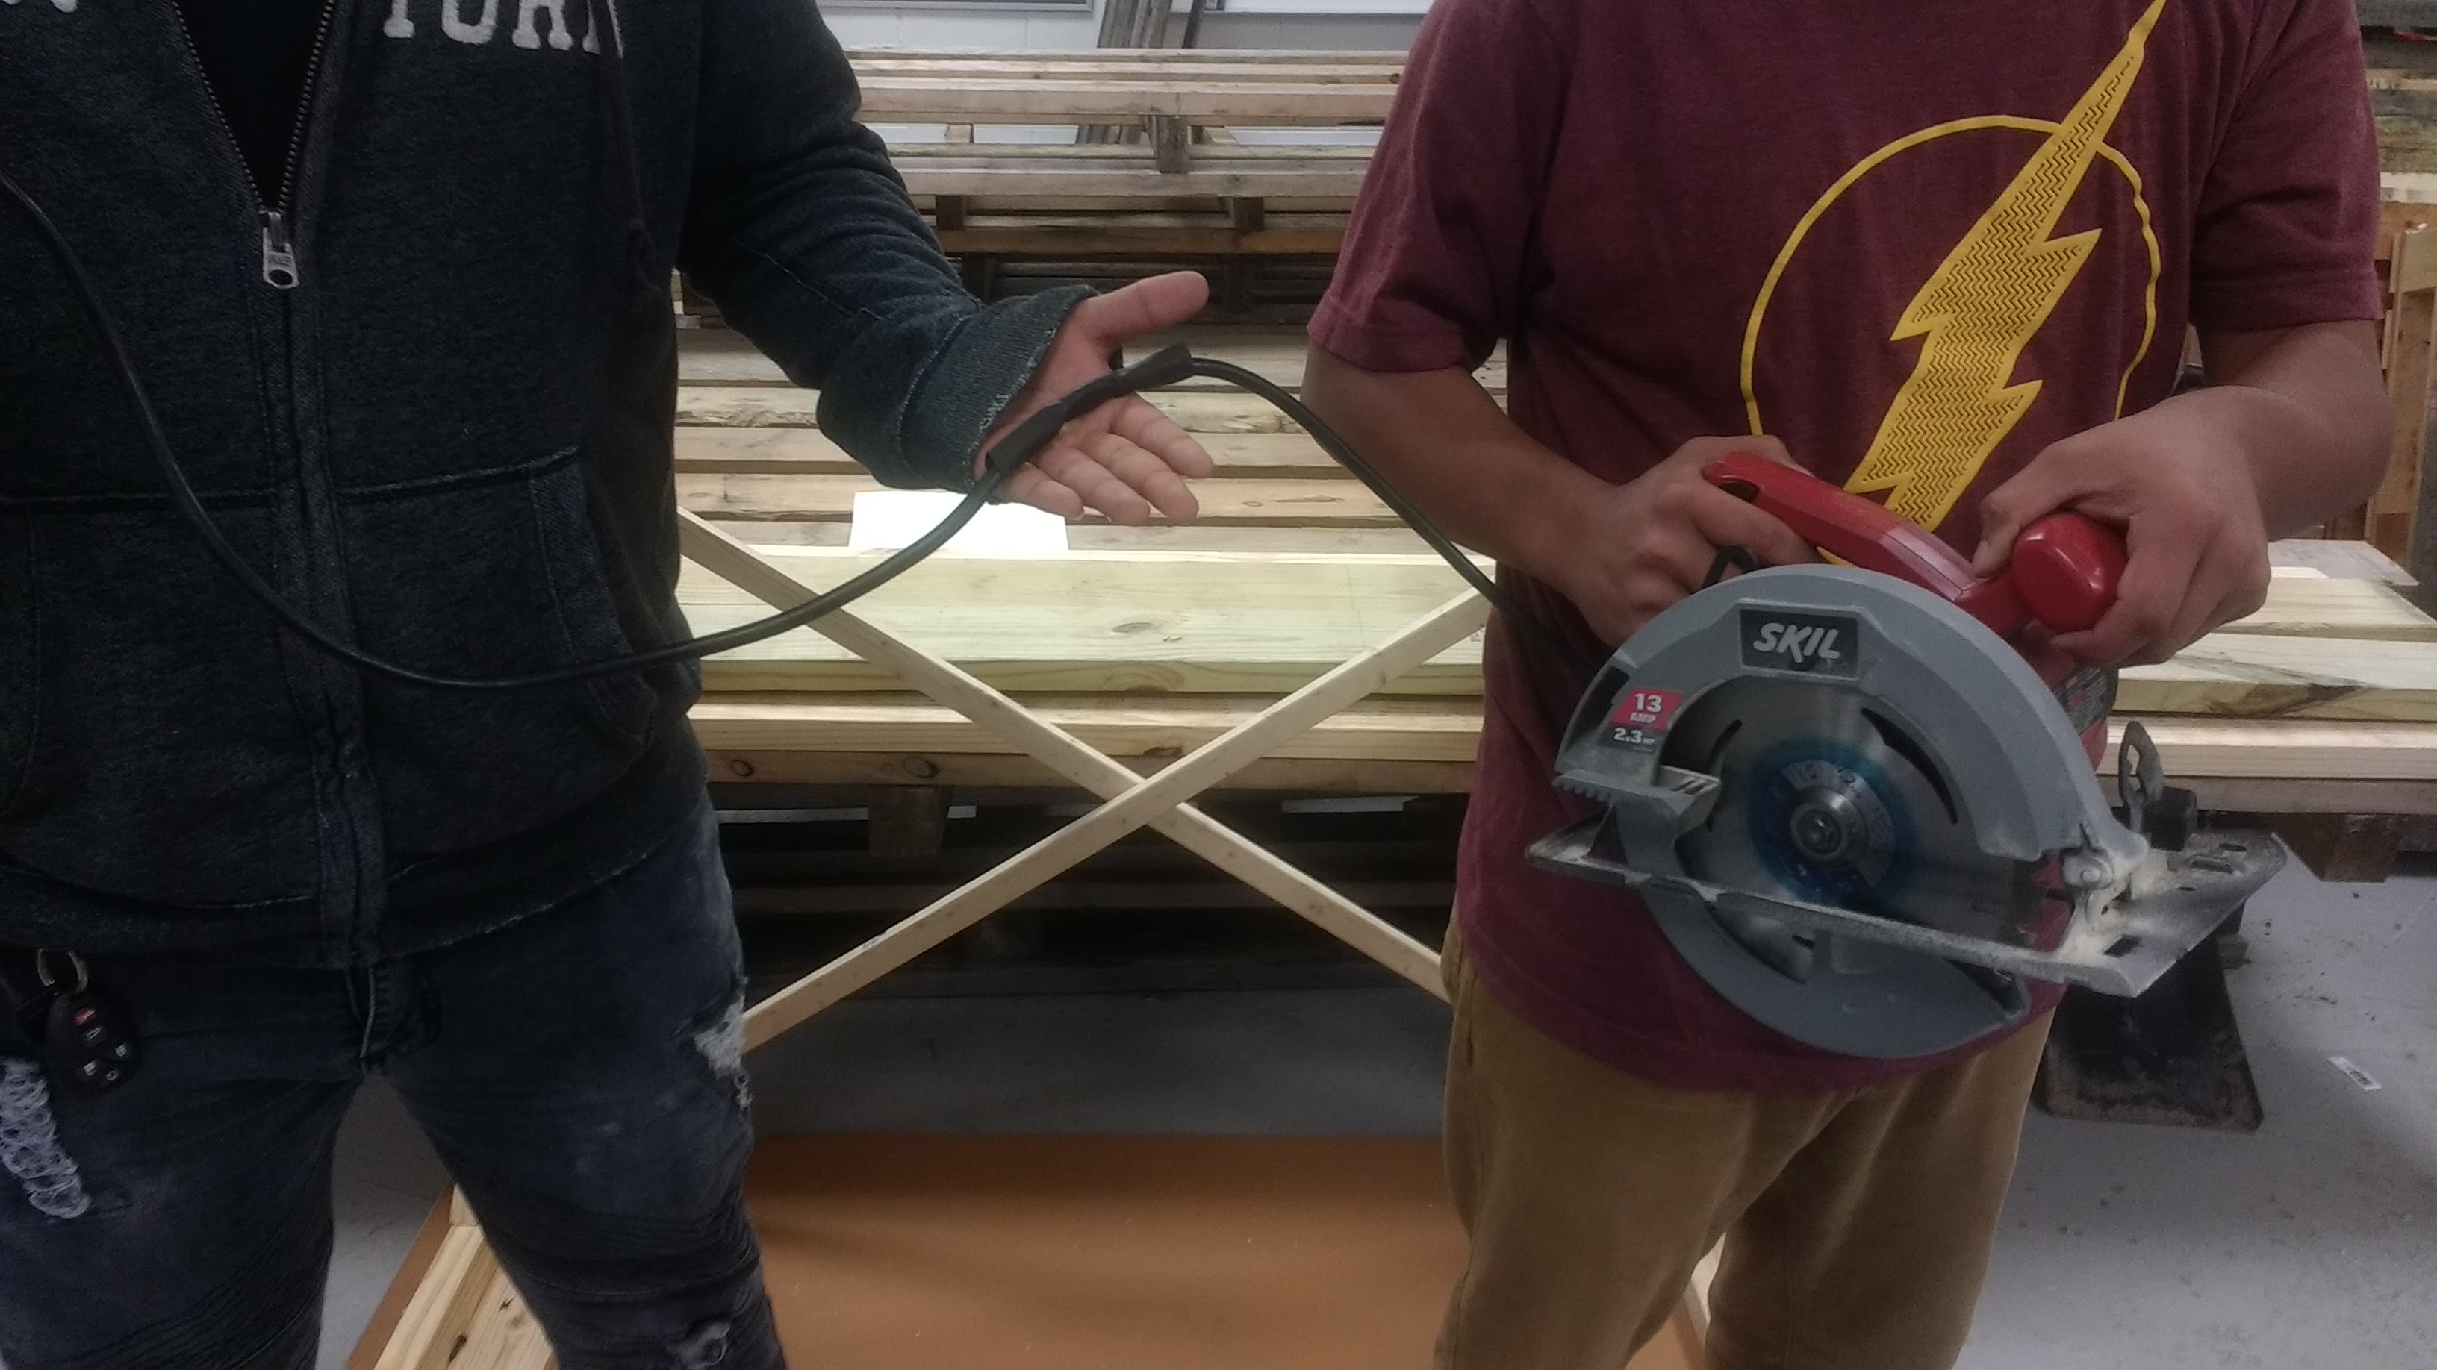
Objectives:
Concerns:
Kickback
Cord
Solutions:
Always hold the saw handle with one hand and the auxiliary handle with the other.
Do not run saw while carrying it at your side. Keep cord away from heat and sharp edges

Slide 3
Concern
Kickback
A kickback occurs when the blade binds on the wood and either throws the wood or the saw itself back at you.

Slide 4
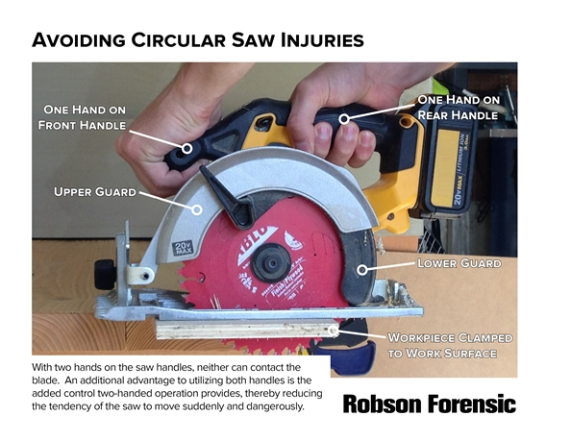
solution
Proper setting of the VARI-TORQUE clutch combined with firm handling of the saw will allow you to control KICKBACK
Wet lumber, green lumber or pressure treated lumber require special attention during cutting operation to prevent KICKBACK
New blade
Some lumbers required special attention
Firm handling of the saw

Slide 5
Concern
Cord damage

Slide 6
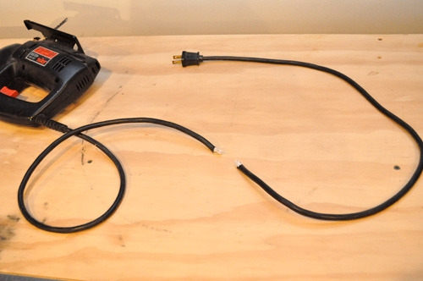
Solution
Always know where your power cord is located. You don’t want to cut through the power cord by accident and electrocute yourself!

Slide 7
Summary
Wear PPE
Ensure that blade is tight.
Check that blade guard is working correctly before you connect the saw to the power source.
Before you cut through anything, find out what is on the other side. Avoid cutting water lines or electrical wiring.
Keep both hands on the saw grips while operating the saw.
Do not run saw while carrying it at your side
Wait for the saw blade to stop moving before setting down

