Slide 1
APA Style
Gavilan College Writing Center
In-Text Citations and Reference Lists

Slide 2
Presentation Overview
Why APA?
Crediting Sources: What and Why
Formatting In-Text Citations
Formatting Reference Lists
Resources

Slide 3
Why APA?
Different professions use different manuals
Modern Language Association (MLA)
English Studies
Foreign Language and Literatures
American Psychological Association (APA)
Social Sciences (Psychology, Sociology, Communications, etc.)
Nursing
Chicago Style
History
Arts
Sciences

Slide 4
What does it mean to credit sources?
Crediting sources gives an author or resource credit for original information. Crediting sources in your paper includes two parts:
In-Text Citations: When you present information in the body of your paper, you briefly identify its source.
Reference List: On a separate page at the end of your paper, you write a detailed list of the sources cited in your paper.
The in-text citations and reference list should credit the exact same sources.

Slide 5
Why credit sources?
Acknowledge authors for their ideas
Avoid plagiarism
Increase credibility and transparency
Join an ongoing academic discussion
Become a part of a professional community

Slide 6
What should you credit?
Any information that you learned from another source including facts, statistics, opinions, theories, photographs, and charts
Credit these sources when you mention their information in any way (quotations, summaries, paraphrases)
EXCEPTION: Information that is common knowledge
Barack Obama was the president of the United States.
The declaration of independence was signed July 4, 1776.

Slide 7
In-Text Citation Format
An in-text citation usually includes the following information:
Author’s last name (no first name or initial)
Publication date (year only—even for electronic sources)
Page number (required for quotations; optional for paraphrases)
The rest of the information about the source appears in the reference list.

Slide 8
In-Text Citation Format
Author’s name and publication year at end of sentence
People with bipolar disorder often have lower wages, higher unemployment, work absenteeism, reliance on workmen’s compensation, higher rates of divorce, lower levels of educational attainment, higher arrest rates, and hospitalization (Leahy, 2007).
Author’s name in the sentence immediately followed by year
According to Leahy (2007), people with bipolar disorder often have lower wages, higher unemployment, work absenteeism, reliance on workmen’s compensation, higher rates of divorce, lower levels of educational attainment, higher arrest rates, and hospitalization.

Slide 9
In-Text Citations with Quotations (under 40 words)
Author’s name, year, and page number immediately following quotation
Genres are “abstract, socially recognized ways of using language” (Hyland, 2003, p. 21).
Author’s name in the sentence immediately followed by year
Page number immediately following quotation
According to Hyland (2003), genres are “abstract, socially recognized ways of using language” (p. 354).

Slide 10
In-Text Citations
 | Basic | Author Name in Sentence
When you summarize or paraphrase a source | (Leahy, 2007) | Leahy (2007)
When you quote a source | (Hyland, 2003, p. 21) | Hyland (2003) “…” (p. 21)

Slide 11
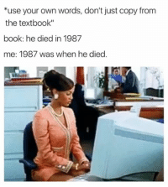
Paraphrasing
Paraphrasing means to tell something in your own words without changing the meaning.
Example:
Children that have suffered with the disease of asthma, cystic fibrosis and other chronic pulmonary diseases, are now able to wear respiratory monitors to track the rate and volume of their breath. (University of California-Irvine,2019).

Slide 12
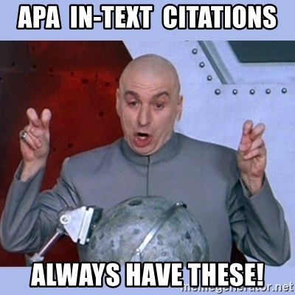
According to Vo (2019), “when creating electrical fences, it is important to ensure the engineering process design is effective”(p.22).
Is the a direct quote or paraphrase?
Direct Quote

Slide 13
Let’s Practice!
Author’s last name: Gee
Year of publication: 2005
Page number: 8
Another viewpoint is that the meaning of language is inherently social.
Another viewpoint is that “language has meaning only in and through social practices.”
The recent theory that “language has meaning only in and through social practices” lends support for social learning theories.
Gee believes that the meaning of language is inherently social.
Gee’s theory that “language has meaning only in and through social practices” lends support for social learning theories.

Slide 14
Let’s Practice!
Author’s last name: Gee
Year of publication: 2005
Page number: 8
Another viewpoint is that the meaning of language is inherently social (Gee, 2005).
Another viewpoint is that “language has meaning only in and through social practices.”
The recent theory that “language has meaning only in and through social practices” lends support for social learning theories.
Gee believes that the meaning of language is inherently social.
Gee’s theory that “language has meaning only in and through social practices” lends support for social learning theories.

Slide 15
Let’s Practice!
Author’s last name: Gee
Year of publication: 2005
Page number: 8
Another viewpoint is that the meaning of language is inherently social (Gee, 2005).
Another viewpoint is that “language has meaning only in and through social practices” (Gee, 2005, p. 8).
The recent theory that “language has meaning only in and through social practices” lends support for social learning theories.
Gee believes that the meaning of language is inherently social.
Gee’s theory that “language has meaning only in and through social practices” lends support for social learning theories.

Slide 16
Let’s Practice!
Author’s last name: Gee
Year of publication: 2005
Page number: 8
Another viewpoint is that the meaning of language is inherently social (Gee, 2005).
Another viewpoint is that “language has meaning only in and through social practices” (Gee, 2005, p. 8).
The recent theory that “language has meaning only in and through social practices” (Gee, 2005, p. 8) lends support for social learning theories.
Gee believes that the meaning of language is inherently social.
Gee’s theory that “language has meaning only in and through social practices” lends support for social learning theories.

Slide 17
Let’s Practice!
Author’s last name: Gee
Year of publication: 2005
Page number: 8
Another viewpoint is that the meaning of language is inherently social (Gee, 2005).
Another viewpoint is that “language has meaning only in and through social practices” (Gee, 2005, p. 8).
The recent theory that “language has meaning only in and through social practices” (Gee, 2005, p. 8) lends support for social learning theories.
Gee (2005) believes that the meaning of language is inherently social.
Gee’s theory that “language has meaning only in and through social practices” lends support for social learning theories.

Slide 18
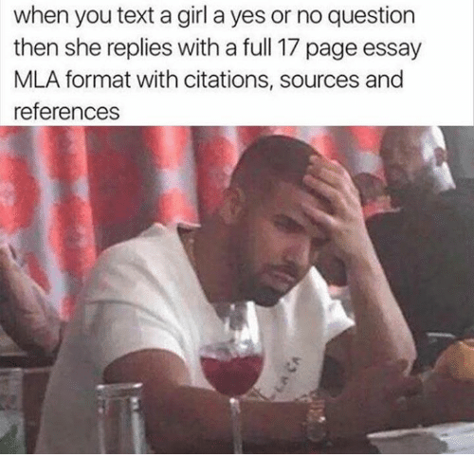
Let’s Practice!
Author’s last name: Gee
Year of publication: 2005
Page number: 8
Another viewpoint is that the meaning of language is inherently social (Gee, 2005).
Another viewpoint is that “language has meaning only in and through social practices” (Gee, 2005, p. 8).
The recent theory that “language has meaning only in and through social practices” (Gee, 2005, p. 8) lends support for social learning theories.
Gee (2005) believes that the meaning of language is inherently social.
Gee’s theory that (2005) “language has meaning only in and through social practices” (p. 8) lends support for social learning theories.

Slide 19
In-Text Citations: Multiple Authors
 | Basic | Author Names in Sentence
2 Authors | (Verhaak & de Haan, 2007) | Verhaak and de Haan (2007)
3-5 Authors | first citation (Zandt, Prior, & Kyrios, 2006) subsequent citations (Zandt et al., 2006) | first citation Zandt, Prior, and Kyrios (2006) subsequent citations Zandt et al. (2006)
6+ Authors | (Storch et al., 2006) | Storch et al. (2006)

Slide 20
In-Text Citations: Other Variations
 | Basic | Author Name(s) in Sentence
Group as Author | (University of Pittsburgh, 2007) | University of Pittsburgh (2007)
No Author | (“Study Finds,” 2007) (College Bound Seniors, 2008) | “Study Finds” (2007) College Bound Seniors (2008)
No Publication Date | (Basham, n.d.) | Basham (n.d.)
Multiple Pages | (Gee, 2005, pp. 8-9) | Gee (2007)…(pp. 8-9)
No Page Numbers | (Brown, 2007, para. 6) | Brown (2007)…(para. 6)

Slide 21
In-Text Citations: Other Variations
 | Basic | Author Name(s) in Sentence
Two primary authors with the same last name | (M. Light, 2008) (L. Light, 2006) | M. Light (2008) L. Light (2006)
Multiple works by the same author in the same year | (Derryberry & Reed, 2005a) (Derryberry & Reed, 2005b) | Derryberry & Reed (2005a) Derryberry & Reed (2005b)
Multiple works by the same author in the same citation | (Gogel, 1990, 2006) | Gogel (1990, 2006)
Multiple works by different authors in the same citation | (Minor, 1999; Shafranske & Mahoney, 1998) | N/A

Slide 22
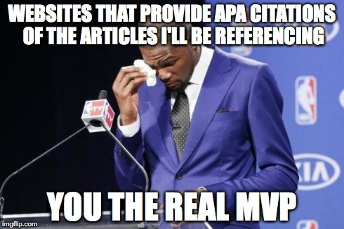

Slide 23
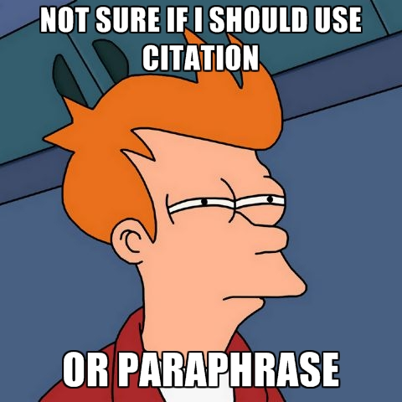
EXIT TICKET
Why are citations important?
How would you feel about your ideas or work were used without giving credit?

